Slide 1
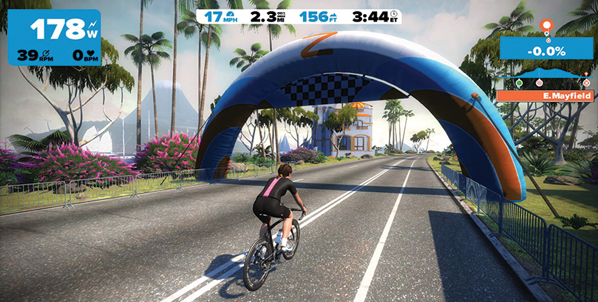
Zwift – An Introduction for Triathletes
In Association with BikeWatts

Slide 2
Zwift – An Introduction for Triathletes
What is Zwift
How it can be used by triathletes
Training with Zwift
Training with power / Power in Zwift
What equipment do you need?
The TTC Zwift Race
Notes:
Today we will be showing you what Zwift is and how it can be used to train and have some fun.

Slide 3
What is Zwift?
Zwift is an online riding environment
Uses your existing bike sensors
Create virtual Avatar
Customise look of your avatar and bike
Ride with others
Includes drafting dynamics
Has training plans
Includes 1 month / 50km free trial ride
$10 USD per month after that
Not Affiliated with TTC or BikeWatts
Notes:
Zwift is an online training environment. It is software that you download and install on your computer which when run connects you with thousands of other riders all over the world.
It works with your existing bike sensors, like your speed sensor, cadence sensor, and power meter
You create a virtual avatar to represent you as a rider in the virtual world
You can customize the look of your rider, including choosing different bikes.
The more you ride in Zwift the more options are opened up for customization
You can ride with other riders, including selecting specific riders to ride with
The world includes drafting dynamics so that means if you are riding behind another rider in the virtual world you get similar benefits to drafting in the real world
Zwift has recently added the ability to ride specific training plans in the virtual world which means it is a great tool for your winter training plans
The free trial includes 1 month of riding, up to 50km in the virtual world. After that it costs $10 per month
Zwift is not affiliated in any way with the club or bike watts. We do not have any group discounts or extended free trials.

Slide 4
How Triathletes can use Zwift
Change up your indoor training
Use workouts to train to specific plan
Race with the club
Notes:
Zwift is a great way to make indoor bike training that we all have to do, much more interesting. It allows you to do group riding at a time when that is impossible in Toronto!
You can use the workouts mode to get specific training in while still following your virtual avatar and riding with others.
We are creating a club race, which I will cover more about later!

Slide 5
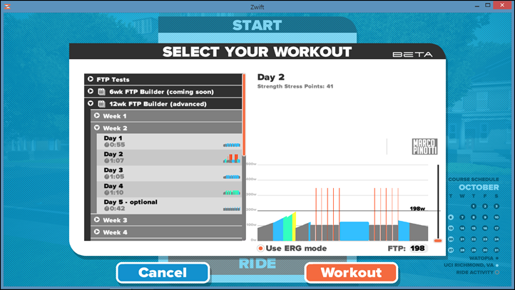
Training with Zwift
Zwift workout mode
Perform an FTP test
Select your workout
Follow a Zwift plan
Follow your own plan in Zwift
Notes:
The Zwift workout mode is where you can get to the specific training plans
The first thing you will need to do is perform a Functional Threshold Power test. This allows the system to get a baseline measurement of where your power output abilities are
Once the system has a baseline, you can work select your workouts.
You can either manually select the workout you want to ride when you start, or you can follow a zwift training plan to work on specific items like increasing power, or improving endurance.
You can also follow our own trianign plan in zwift.

Slide 6
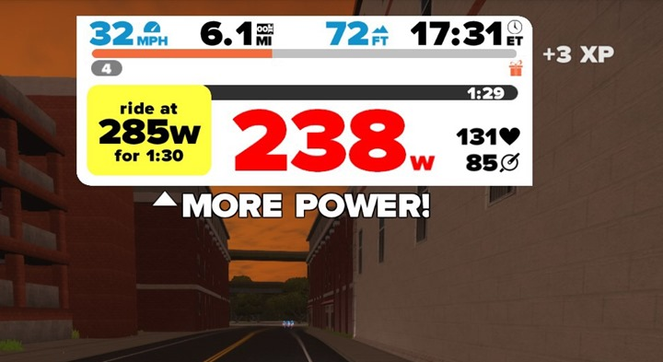
Training with power / Power in Zwift
Power is a measure of the work effort you are putting in on the bike
To train with power requires a power enabled bike trainer, or a power meter
Without these power is Zwift is estimated and may not be accurate
Power is measured in Watts
The actual number is not that relevant, the power to weight ratio is the only way to measure yourself against another rider
Notes:
The basis of zwift is training with power. Power is simply a measurement of how much work you are putting into your effort on the bike.
To properly training with power you will need a trainer that has power functions, or a power meter.
Without one or both of these, Zwift is making a estimate of your power by using speed and weight, this is not always very accurate.
Power is always measured in Watts. The actual number is not that relevant and should not be used to compare yourself to other riders. This can be done by using the power to weight ratio, which is how Zwift determines how fast you are moving in the virtual world.

Slide 7
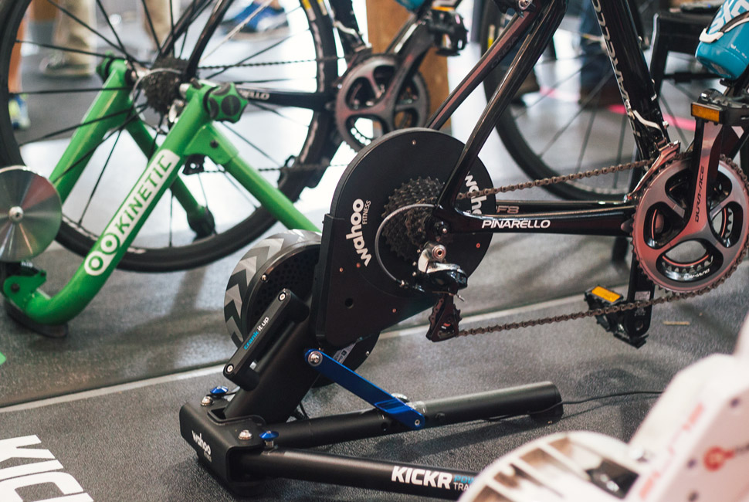
What equipment do you need?
Computer
Ant+ Dongle
Bike trainer
Basic Trainer
With a basic trainer you need a speed sensor with Ant+ capabilities
Power Meter
If you have a power meter you can pair it with zwift for a more accurate measure of effort
Smart Trainer
A smart trainer is the most immersive way to use Zwift. It will vary the resistance based on the course and drafting dynamics on Wattopia

Slide 8
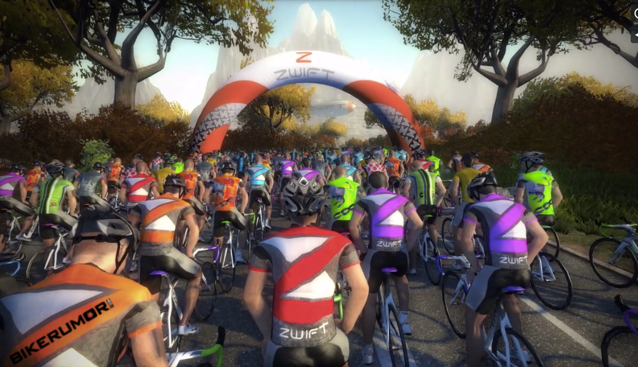
The Zwift TTC Race
TTC will be doing a Zwift race in the new year
Dates to be finalized, but will be between the 1st and 3rd of January
Open to all TTC members of all levels
May lead to a monthly race if successful

